Slide 1


MEENAKSHI COLLEGE OF ENGINEERING N0-12 , Vembuli Amman Koil Street , West K.K Nagar , Chennai – 600 078
DEPARTMENT OF INFORMATION TECHNOLOGY
NAAN MUDHALVAN
Title : Grocery Web App
TEAM MEMBERS :
COORDINATOR:
Mrs. Y. Angeline Gnana Prakasi
JASMINE PRESILLA J - 311421205032
KIRTHIGA R - 311421205041
MAHALAKSHMI A - 311421205044
MAHALAKSHMI V - 311421205045

Slide 2
CONTENTS
OBJECTIVE
PURPOSE & SCOPE
INTRODUCTION
EXISTING SYSTEM
PROPOSED
PROPOSED MODULES
CODING APPROACH
ARCHITECTURE DESIGN
UI DESIGN
RESULTS & DISCUSSION
CONCLUSION
FUTURE ENCHANCEMENT

Slide 3
OBJECTIVE
The objective of the MERN stack grocery web app is to provide a user-friendly, efficient platform for seamless online grocery shopping. It enables users to browse, search, and purchase products while allowing store admins to manage inventory and orders. With a robust backend, secure payments, real-time updates, and personalized recommendations, the app ensures fast performance, cross-platform accessibility, and a smooth shopping experience.

Slide 4
PURPOSE
The grocery web app simplifies online shopping by offering a secure, efficient, and user-friendly platform. It enhances the customer experience with easy browsing and purchasing, while helping store admins manage inventory and orders. The app meets the growing demand for digital solutions with accessibility, personalization, and reliability.
SCOPE
The grocery web app provides a seamless shopping experience for customers and tools for businesses to manage operations efficiently. It features advanced search, real-time updates, secure payments, and inventory management, with scalability for future enhancements like delivery tracking and loyalty programs.

Slide 5
INTRODUCTION
The grocery web app, built with the MERN stack (MongoDB, Express.js, React.js, and Node.js), offers a seamless online shopping experience for customers with features like easy browsing, secure payments, and real-time stock updates. It also provides store administrators with tools for inventory management, order processing, and sales tracking. The app ensures scalability, reliability, and performance, making it adaptable to the growing demand for digital grocery solutions. With a focus on user experience and efficient backend management, it aims to enhance both customer and business operations.

Slide 6
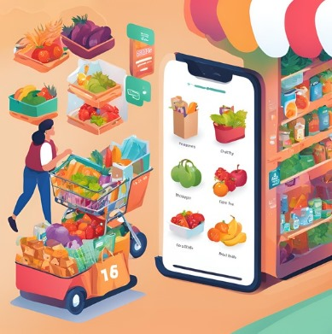
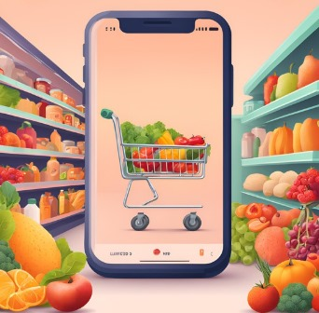
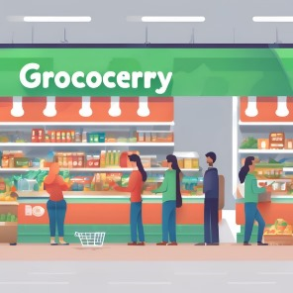
EXISTING SYSTEM
.
Time Constraints
Limited Selection
Long Checkout Lines
Traditional grocery shopping can be time-consuming, especially for busy individuals.
Physical stores may have a limited variety of products compared to online retailers.
Waiting in long queues at the checkout can be frustrating and inefficient.

Slide 7



PROPOSED
Time Efficiency
1
24/7 access for convenient, anytime shopping.
Wide Product Selection
2
Extensive inventory, including specialty items.
Streamlined Checkout
3
Fast, secure online payment with no waiting.

Slide 8
PROPOSED MODULES
User Module:
Register/Login: Users can register or log in to access personalized features.
Product Search and View: Allows users to browse and view product details.
Add to Cart and Checkout: Products can be added to the cart, with a streamlined checkout process.
Payment Options: Supports both online payment and cash-on-delivery options.
Logout: Users can securely log out after placing an order.
8

Slide 9
Admin Module:
Category and Product Management: Admins can add categories and products to the catalog.
Order Management: Admins can view and update order statuses.
Payment Tracking: Ensures payment verification for completed orders.
Feedback and Reports: Admins can review user feedback and generate reports for analytics.
9

Slide 10
CODING APPROACH
Frontend Development:
React.js used for building a responsive and interactive user interface.
Functional components created for modularity and ease of maintenance.
React Router employed for efficient navigation between pages.
Backend Development:
Node.js and Express.js implemented for server-side logic.
API endpoints designed for CRUD operations like user authentication, product management, and order processing.
Middleware integrated for request validation, routing, and error handling.

Slide 11
Database Integration:
MongoDB used to store user data, product catalogs, and order history with a flexible NoSQL schema.
Authentication and Authorization:
JWT (JSON Web Tokens) used for secure user login and authentication.
Password hashing implemented using bcrypt for data security.
Payment Gateway Integration:
A third-party payment gateway API added to facilitate safe and secure transactions.
Environment Variables:
Configured sensitive data (e.g., API keys) using .env files for security.

Slide 12
State Management:
State managed using React Context API or Redux to handle global states like user authentication and cart functionality.
Error Handling:
Proper error handling added at both frontend and backend to improve app reliability.
API Testing:
Used Postman to test API endpoints for accurate data transfer between frontend and backend.
Deployment:
Frontend hosted on Netlify, backend deployed on Render, ensuring reliable performance.

Slide 13




ARCHITECTURE DESIGN
Frontend (Web & Mobile)
Built with React.js for a dynamic and responsive user interface.
Backend (API & Logic Layer)
Node.js and Express.js for API development and server-side logic.
Database (MongoDB)
Stores product listings, user data, order details, and inventory status.
Third-Party Integrations
Payment Gateway for secure transactions, Geolocation Services for delivery estimation and store locations, Notification Services for SMS, email, or push notifications.

Slide 14
UI DESIGN
Wireframes / Mockups
User Experience (UX) Flow
Key screens include a clean homepage with product categories, a search bar, and promotions.
Users begin on the homepage, either searching for items or browsing categories.
Responsive Design
The layout is optimized for both mobile and desktop, with collapsible menus, responsive grids, and touch-friendly buttons on smaller screens.

Slide 15
RESULTS AND DISCUSSION
User-Friendly Interface: The app provides an intuitive and seamless shopping experience, allowing users to easily browse, search, and purchase groceries.
Secure Transactions: Integration of JWT authentication and a secure payment gateway ensures data safety and secure payments.
Efficient Management: Store owners benefit from streamlined product management, inventory tracking, and sales monitoring through the admin panel.
Scalability: The MERN stack architecture ensures the app can handle increased traffic and supports future enhancements like multi-store functionality.

Slide 16
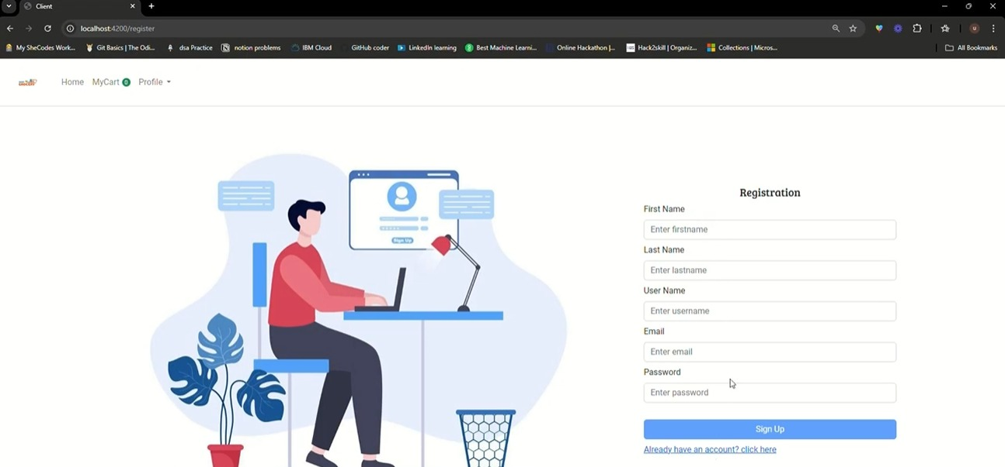
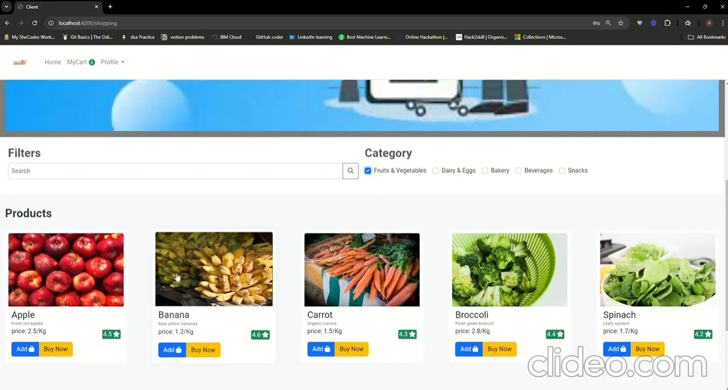
User Registration and Login Page
Product Search and Filter Page
Allow users to create accounts, log in, and manage profiles.
Users can search for products by name, category, and apply filters like price or availability.

Slide 17
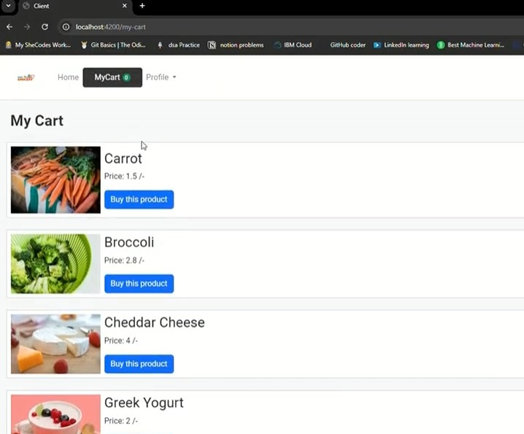
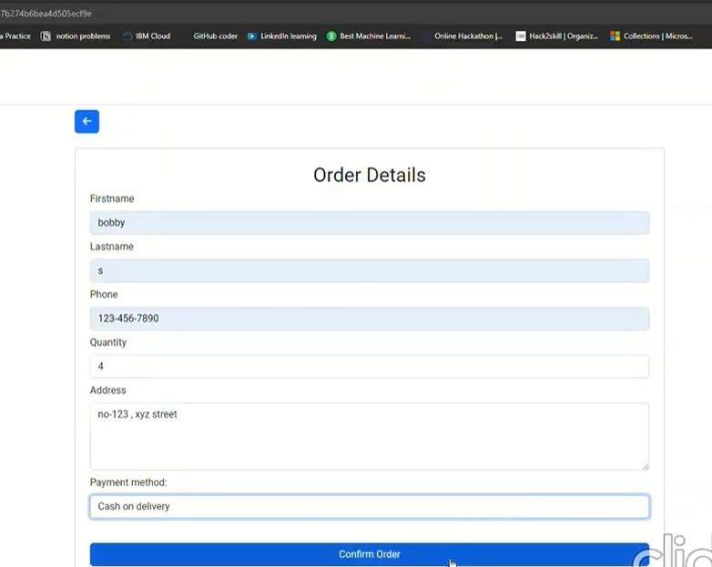
Shopping Cart and Checkout Page
Payment Gateway Integration Page
Secure payment options (e.g., credit/debit, PayPal, mobile wallets, Cash on Delivery).
Users can add items to a cart, and view My Cart.

Slide 18
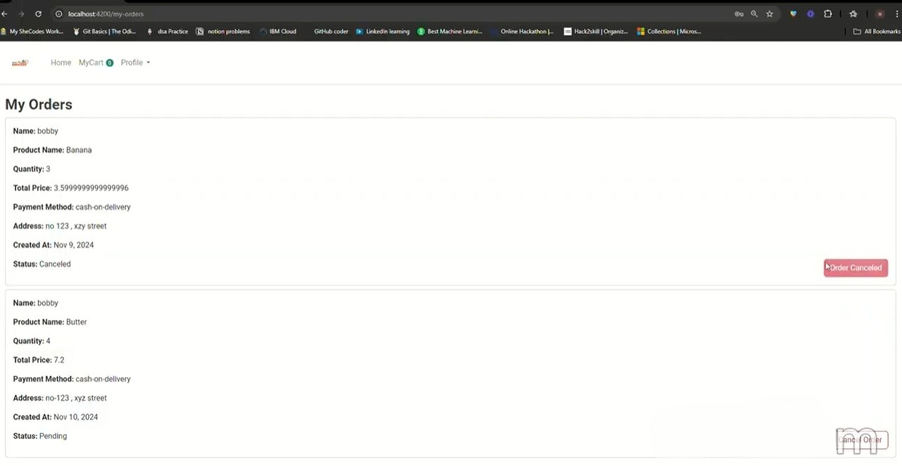
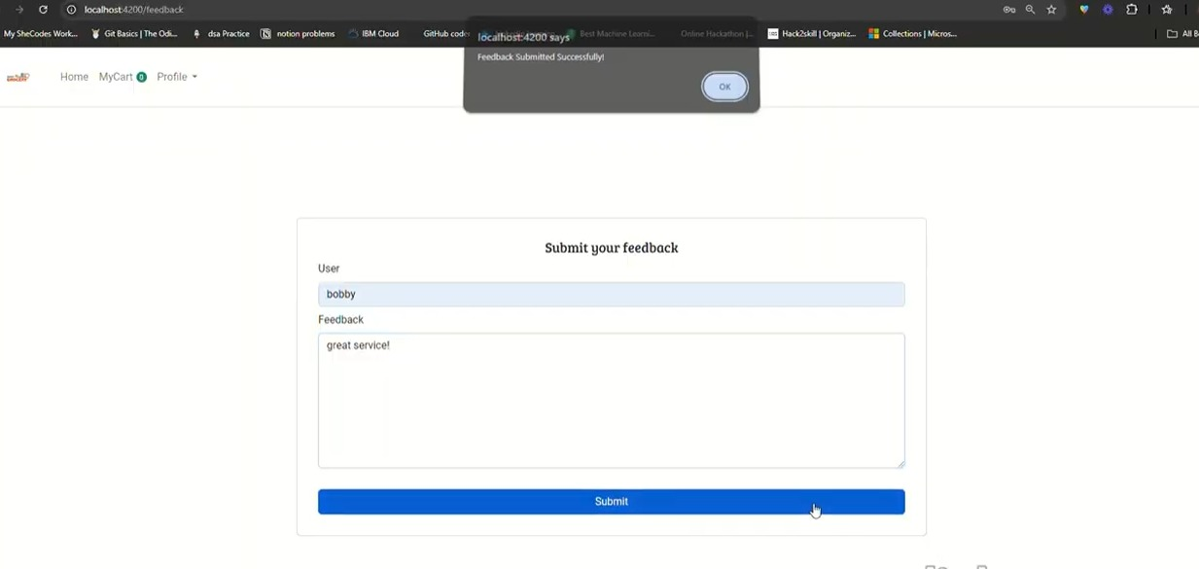
Order Tracking Page
Feedbacks Page
Users can view the status of their orders and can track the order ID.
Users can provide feedback on their experience to help us
improve our services.

Slide 19
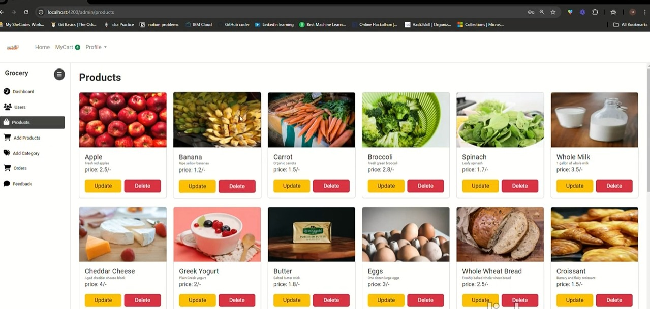
Admin Features
Manage users, add or delete products and categories, update order status, and address customer feedback effectively.
Video Demo Link : https://drive.google.com/file/d/1K3WHSy8rpCMtK2Ega6JLJAKZO4lpf5Vc/view?usp=sharing

Slide 20
CONCLUSION
The grocery web app developed using the MERN stack stands as a robust, scalable, and highly efficient solution to modernize the online grocery shopping experience. With a seamless, user-friendly interface, secure payment integration, and real-time inventory management, the app offers both customers and store owners significant improvements over existing systems. By leveraging cutting-edge technologies and following best practices in software development, the app ensures high performance, security, and scalability. This project not only meets its objectives but also provides a solid foundation for future enhancements, positioning it as a valuable tool for the evolving e-commerce landscape.

Slide 21
FUTURE ENHANCEMENT
1
Advanced Delivery Tracking
Integrate geolocation-based tracking for real-time updates on order deliveries.
2
Student Credit Options
Offer flexible payment options like slice cards to support student shoppers with buy-now-pay-later services.
3
Voice Assistance Integration
Enable users to browse and place orders using voice commands for a hands-free experience.
4
Multilingual Support
Provide support for multiple languages to cater to a diverse user base.

Slide 22


KKR & KSR INSTITUTE OF TECHNOLOGY & SCIENCES DEPARTMENT OF EEE

